Slide 1

MKE Black
Black City Collective
Business Plan
Andi Hennessey, Anthony Om, Chris Hampton, Jake Petrie, Jordan Wright, Vicenzo Infusino

Slide 2
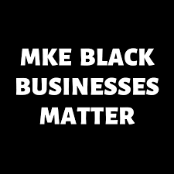
Product Info - Introduction
Design a website to host BLK City Collective for the MKE Black Company, so they can distribute it as a framework to other cities across the US.
Goal: Bring representation of local minority owned businesses in each city
Provide business information such as type of business, location, products, as well as the bio of the business itself, and it will also provide a site for community members to locate and interact with minority owned businesses in their region.
Goal: To help communities that are traditionally underrepresented and to elevate their presences in their respective regions.
“Put the UNITY back in Community”
Allow members of underrepresented communities to find these minority owned businesses and support them intentionally - targeting young adults in these communities
Notes:
Vinny

Slide 3
User Stories - Business
Jacob is a 32 year old black business owner that started his own musical instrument business in Jackson, Mississippi. The business itself specializes in the selling, and repairing of a variety of musical instruments. From woodwind instruments to big brass instruments, but Jacob’s business also offers African Drumming lessons for those that are interested. The problem he has is advertising his business to the local community, and his current advertising methods aren’t leaving much of an impact in the community. Flyers, signs, and a small social media presence fail to bring in enough customers to turn a proper profit. What Jacob would like is a platform where he could post information about his business and location, and share that to all of those in the local community that use this same web platform.
Notes:
Vinny

Slide 4
User Stories - Consumer
Jalah is a 25 year old recent college graduate from Loyola Chicago, and she recently moved to Atlanta, Georgia after pursuing a full-time job opportunity. She’s never visited Atlanta before, and she’s been pretty homesick as of late since her family lives in Chicago, and she has had a hard time making new friends within her community. Also, since her parents are immigrants from Nigeria, she misses their homestyle Nigerian cooking. Jalah has been seeking a way to connect with fellow community members as well as finding local Nigerian restaurants that serve authentic food. In addition, Jalah believes that websites like Yelp and Tripadvisor are too generic for her, and she desires to use a website that is more locally and community focused. Overall, her goal is to utilize a website that will help connect her with the Atlanta community around her, and find restaurants and other businesses that provide Nigerian food and products to connect her with home.
Notes:
Vinny

Slide 5
Stakeholders
Consumers/Users of the BLK City Collective Website - Specifically Young Adults
Young adults are the primary user and target group of the BLK City Collective Website
Will be the ones that use the BLK City Collective Website the most to find Black owned-businesses/events, and to learn more about Black owned businesses and events in the community.
Business Owners that will be featured on BLK City Collective Website
Will be the ones responsible for providing accurate information about their business for the BLK City Collective website, and the most important stakeholder for this website to succeed.
MKE Black Company Executives
The MKE Black Company Executives will be the ones selling BLK City Collective to other cities and working with legal terms of BLK City Collective
People in charge of maintaining the shared database
People hired by BLK City Collective to maintain and update the shared database between website and app
Us as Software Developers
Work with the MKE Black Executives, and designing the BLK City Collective App
Notes:
Vinny

Slide 6

KPI’s Part 1
BLK City Collective - The Businesses Featured and Young Adult Users
Acceptance Criteria (Website):
The website should be able to populate with different businesses (along with their accurate information), and allow interaction between a consumer and a business
User friendly and accessible so that users can discover local community events and businesses
Contain a login page, one for users and one for businesses, so that businesses can interact with customers who favorite their business (and see if their business information is accurate), and customers can interact with businesses as well
Database: Should be shared between the mobile application and the website. It should be kept up to date with the businesses (not including those that don’t exist) and secure.
Documentation: Documentation on how to use the website and database will be provided. Database must be secure and accurate
Code: Source code will also be provided for this website and database as well.
Notes:
Vinny

Slide 7
KPI’s Part 2
MKE Black Company Executives
Acceptance Criteria (Website):
The BLK City Collectie website to contain all of the features of the current MKE Black Website like a list of all the businesses and type of business, location services of all the businesses, and a way for businesses to submit their information for review.
Database:
Shared between mobile application and website
Documentation and Code:
Documents and Source Code will be provided on how to use the website and database
People in charge of maintaining the shared database
Database:
The database should be shared between the mobile application and the website and be easy to access. It should be able to be maintained, and updated easily.
Documentation and Code:
Same as above

Slide 8
Market Survey Data
Deploy the website/application in major cities across the U.S
Growth Estimates
10,000 users within each city, with the expectation to spread the product to 20 different cities
Competitors:
Blaap()
We Buy Black
MercadoMKE
EatOrka
Post 21
BLK City Collective’s main draw is the focus on local community to bring people together
Notes:
Andi - anonymous anteater

Slide 9
Interoperability and Uptime requirements
Database will contain information about various businesses and their location within said community.
Google Firebase will potentially used as database
Website is not “Mission Critical”
The website will serve as a resource tool above all else
Estimated uptime of 96%
There will be times where it will come down if some reworks or updates are needed
Notes:
Andi

Slide 10
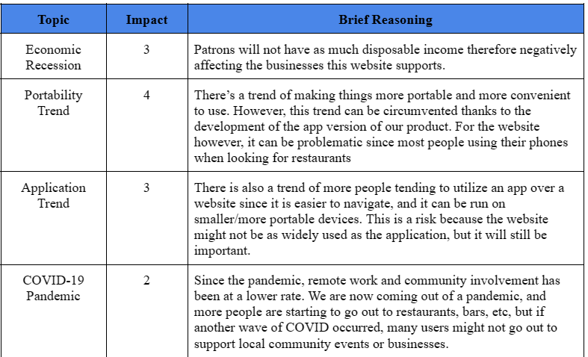
Risks: Broad Market
Notes:
Andi

Slide 11
Product Risks
Product risks include
Data security
Interconnectivity issues
Funding for database usage
And any big changes or decision made by BLK City collective
Notes:
Andi

Slide 12
Advertisement, Sales, and Feature structure
Advertising
Social media platforms
Peer to peer communication with people in the communities
Partnerships with local organizations
Non-profit webinars
Sales
BLK City Collective plans to use business-to-business sales channels and a direct sales campaign
The direct sales campaign includes cold calling and reaching out to other communities, organizations, and locations that would benefit from our product the most
Feature Structure
Standard and Advanced licensing connected to features to be unlocked within the applications API’s or services included.
Support will be a line item to produce revenue and also support the platform.
Notes:
Jordan

Slide 13
Deployment, training, and Monitoring
Deployment
BLK City Collective plan to have the website to be 100% cloud hosted
While hiring other technical personnel to help manage the product while on the cloud.
Training
Documentation on how to use the website and database will be provided as well as the source code in which we used to design the website.
A clickable demo and other presentations shall be left behind to serve as a reference point
Monitoring
The website will not be monitored in real time
Changes will be made as users provide feedback on their user experience.
Notes:
Jordan

Slide 14
Legal
Patent infringement and Filing
Doesn’t seem to be any patent infringement at the current moment
License Agreement
BLK City Collective requires legal terms and conditions, in order to state how we will be using and storing people's data. This will be done by the legal team for BLK City Collective.
Regulatory and Quality System
As we know, the BLK City Collective website that we’re making does not require the aid of a regulatory or quality system. Simply put, there’s nothing that needs heavy regulation as the website servers mainly to inform the customers users about black owned businesses while providing business users a platform to effectively advertise themselves.
Notes:
Anthony

Slide 15
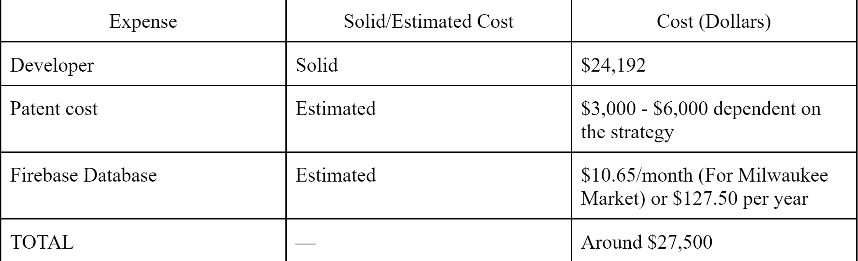
Financial Justification
Deployment Cost
Developer cost: 6 developers working 8 hours a week for 14 weeks at $20/hour is $13,440 with an additional 80% overhead cost on top = $24,192.
Patent cost varies - dependent on strategy
The database usage is pay as you go and is very flexible. Using higher than expected values for the Milwaukee market, Google Firebase estimates a figure of less than $11 per month.
BLK City Collective has no budget for this regarding development allocated at this time.
Notes:
Anthony

Slide 16
Financial Rollup
To start off, there is an expected 10K users upgrade from the MKE Black website. With other communities, organizations, and locations this number will grow.
Future growth goals of 20 organizations with approximately 10k each, totalling 200K in future estimated users of the platform.
Currently a flat pay model is the default. However, for larger markets such as Chicago, a service model.
Estimated net revenue goal of $3,000/month would profit in the first year. The licensing and implementation pricing is yet to be determined, but if each organization was charged $500 dollars per month, it would take 6 organizations to profit the first year.
Notes:
Anthony

Slide 17
Demo
The files for the demo are included in the deliverable - zip file.
To run the demo click on any of the HTML files to open up the webpages.
Link to the demo files: https://drive.google.com/drive/folders/1FQo4EzENPeWPP7U5MU7fSq17TN6Mc4c7?usp=share_link
Basic Steps:
Click on the Dropdown Arrow and then “Download”
Make sure all of the files are in downloaded into one folder
Click on 1 of the HTML Files and open it up in your favorite web browser
Interact!
Notes:
Anthony

